Slide 1
Thesis Protein Translocation through a nanopore
Name- Rajat Chaudhary
Roll No. -17807540
Mentor - Dr. Harshwardhan H. Katkar

Slide 2
Aim
To study the unfolding of a protein molecule translocating through a nanopore, possibly find a correlation between translocation time distribution and secondary structures present in a protein

Slide 3
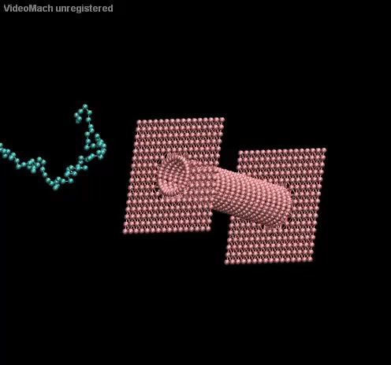
Example Simulation
Simulation time: 2 µs
Movie length: 400 ns
Electric Field outside pore: 10⁸ V/m
Electric Field inside pore: 10⁹ V/m
Bond coefficient: 10 KJ/m²

Slide 4
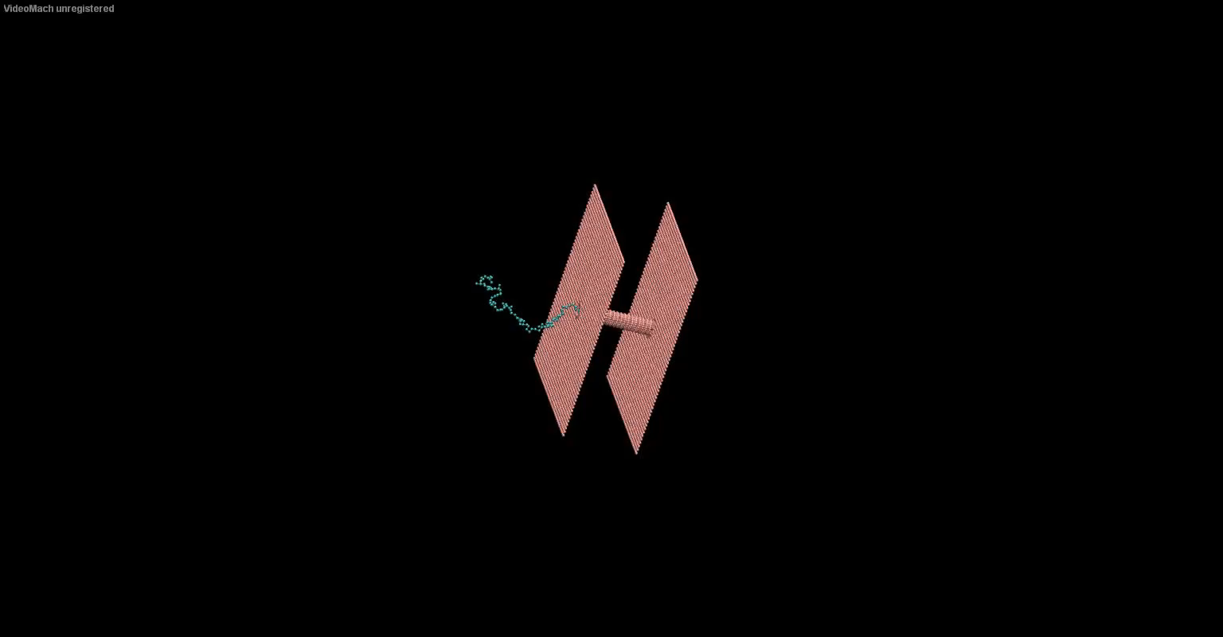

Slide 5
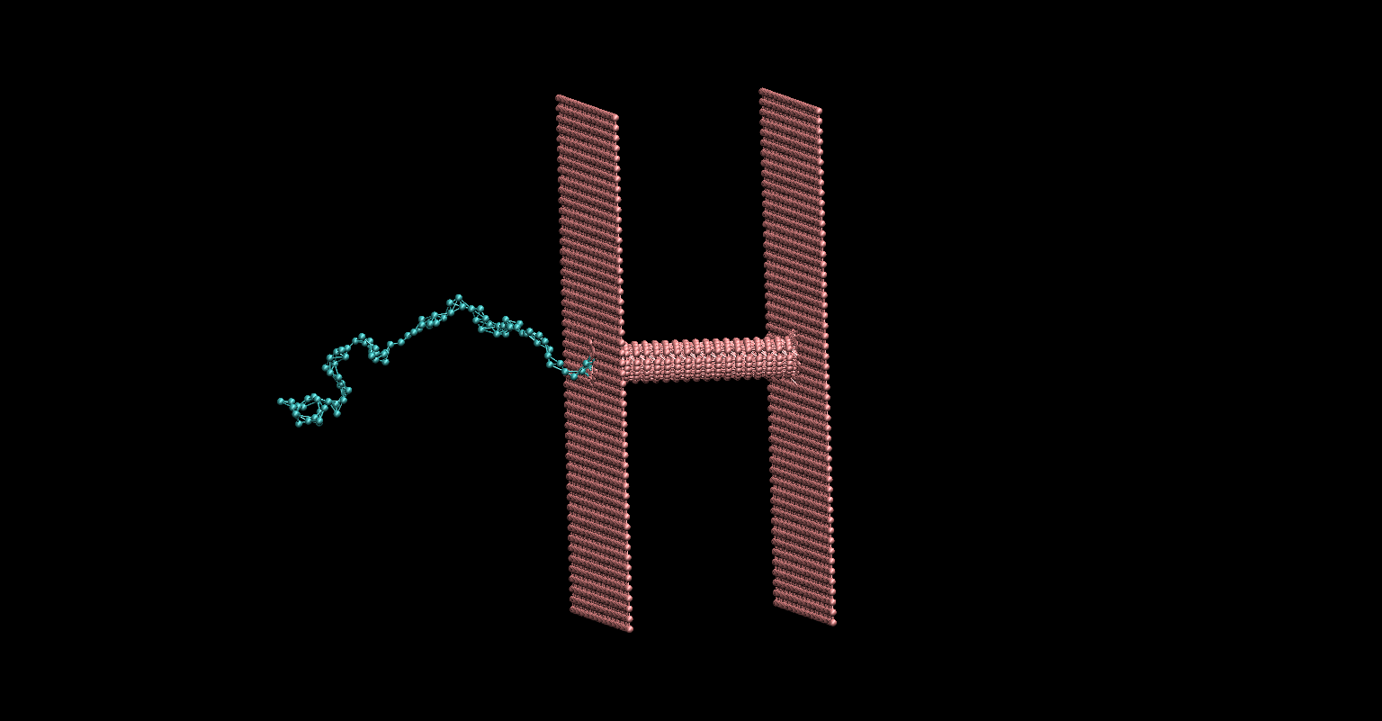
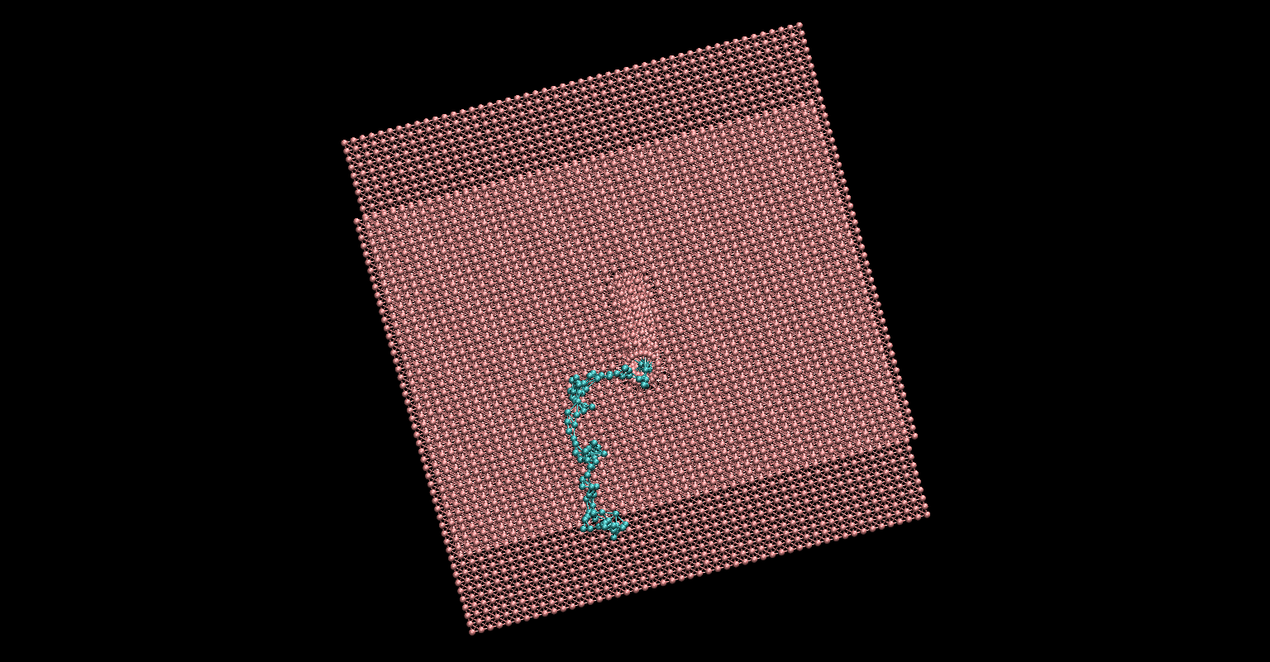
Initial Guesses

Slide 6
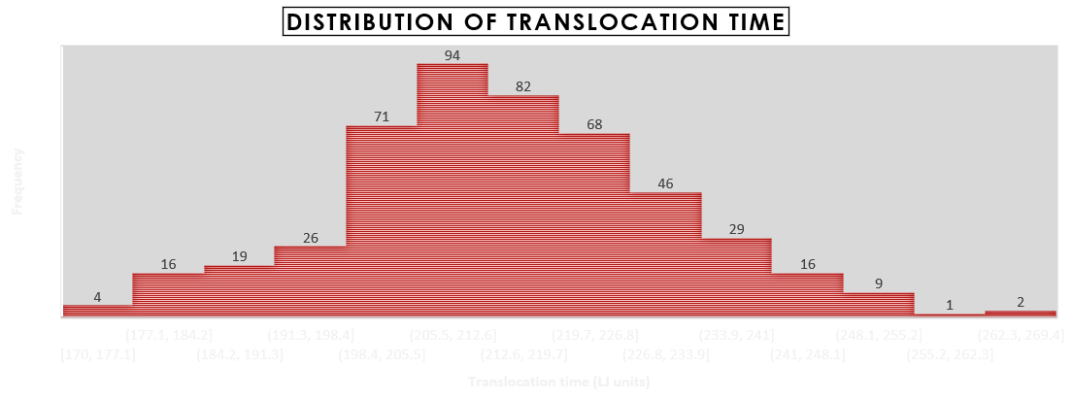
E = 100 * (100 mv per 10 nm or 10^7 V/m) Leading molecule only moves in Z direction 9 molecules didn’t exit, 8 molecules couldn’t enter (3.3 ns simulation time per simulation)
1 LJ unit time = 2.174 * 10 ⁻¹² s

Slide 7
Coarse Grain Model
Atomistic detail makes simulations slow
Some atoms can be lumped together to form a single entity and now these entities form the basis of the simulation instead of the single atoms
Reduces details but also reduces simulation time drastically
Important to choose right scale so that the simulation is neither insufficiently detailed nor too slow

Slide 8
Protein CG models
AWSEM | Up to three-bead representation: Cα, Cβ, and O | Model used for ab initio structure prediction of globular proteins prediction of dimerization interfaces of protein–protein complexes modeling the mechanisms of misfolding and aggregation role of electrostatic effects in protein folding and binding AWSEM has been also extended to model α-helical transmembrane proteins.
 | Mixed (knowledge-based and physics-based) potential | Available as open source software
Bereau and Deresno model | Up to four-bead representation: three backbone beads (N, Cα and C′) and one side chain bead located at Cβ. | Model used for studying protein folding and protein aggregation Studies show that additional model tuning is needed to improve the stability of proteins with β-type or α/β-mixed secondary structure.
 | Knowledge-based force field | Available as part of the ESPRESSO package
CABS (C-alpha, c-beta, side chain) model | Up to four-bead representation: Cα, Cβ, center of the side chain, and center of the peptide bond. Additionally, restriction of Cα positions to the cubic lattice (with 0.61 Å spacing) significantly speeds up the calculations. | Model used in template-based/ab initio protein structure prediction, loop structure prediction ab initio simulations of protein folding and binding of intrinsically disordered proteins. Used as a simulation engine in multiscale methods for protein structure prediction, modeling of protein flexibilityand flexible protein-peptide docking.
 | Knowledge-based force field | Available with CABS-based tools
MARTINI model | Up to five-bead representation: one backbone bead (placed at the center of mass of the amino acid backbone), and up to four side chain beads. | Model originally developed for lipids and subsequently extended to proteins. Most popular model for the coarse-grained modeling of membrane proteins in the membrane environment.
 | Physics-based force field | Available at: http://www.cgmartini.nl/
OPEP (optimized potential for efficient protein structure prediction) model | Up to six-bead representation: full-atom for the backbone (N, HN, Cα, C′, and O) and single-bead for side chains (with an exception of proline having three beads). | Model used for protein folding; aggregation studies; structure prediction of peptides and small proteins; modeling of the role of hydrodynamics in protein relaxation and peptide aggregation; modeling of proteins, DNA-RNA complexes and amyloid fibril formation in a crowded environment; ab initio peptide structure prediction.
 | Mixed (knowledge-based and physics-based) potential | Available with OPEP-based tools

Slide 9
Protein CG models
PaLaCe (Pasi-Lavery-Ceres) model | Two-tier representation (one for bonded and another one for nonbonded interactions). Three backbone beads (N, Cα, and C′) are used for backbone representation and one or two beads for the side chain | Model used to maintain structures of folded proteins, and model their dynamic fluctuations and large-scale force-induced conformational changes protein flexibility prediction.
 | Physics-based force field | Available within the MMTK simulation package
PRIMO model | Up to seven-bead representation: three backbone beads (N, Cα, and combined CO) and one to five beads for the side chain (the representation was aimed to be sufficient for high resolution protein representation | Model used in peptide and small protein structure prediction; has been extended to membrane environments.
 | Physics-based force field | Available from the authors on request and distributed as part of the MMTSB Tool
Rosetta model | Representation by all backbone atoms, Cβ and center of the side chain. Coarse-grained models are further refined in all atom representation (with explicit hydrogen atoms). | Model widely used for protein structure prediction, model implemented in numerous pipelines for protein–protein docking, protein–ligand docking, antibody modeling, refinement of crystallographic structures, refinement of NMR structures, protein-peptide docking, modeling of protein–DNA interactions.
 | Mixed (knowledge-based and physics-based) potential | Available at https://www.rosettacommons.org/
UNRES (united residue) model | Three-bead representation: Cα, peptide-group, and side chain. | Used in numerous protein folding studies; protein structure prediction; loop structure prediction; protein–protein interactions; protein–DNA interactions; mechanisms of protein fibrillation, large-scale rearrangements of protein complexes.
 | Physics-based force field | Available with accompanying tools at: http://www.unres.pl/

Slide 10
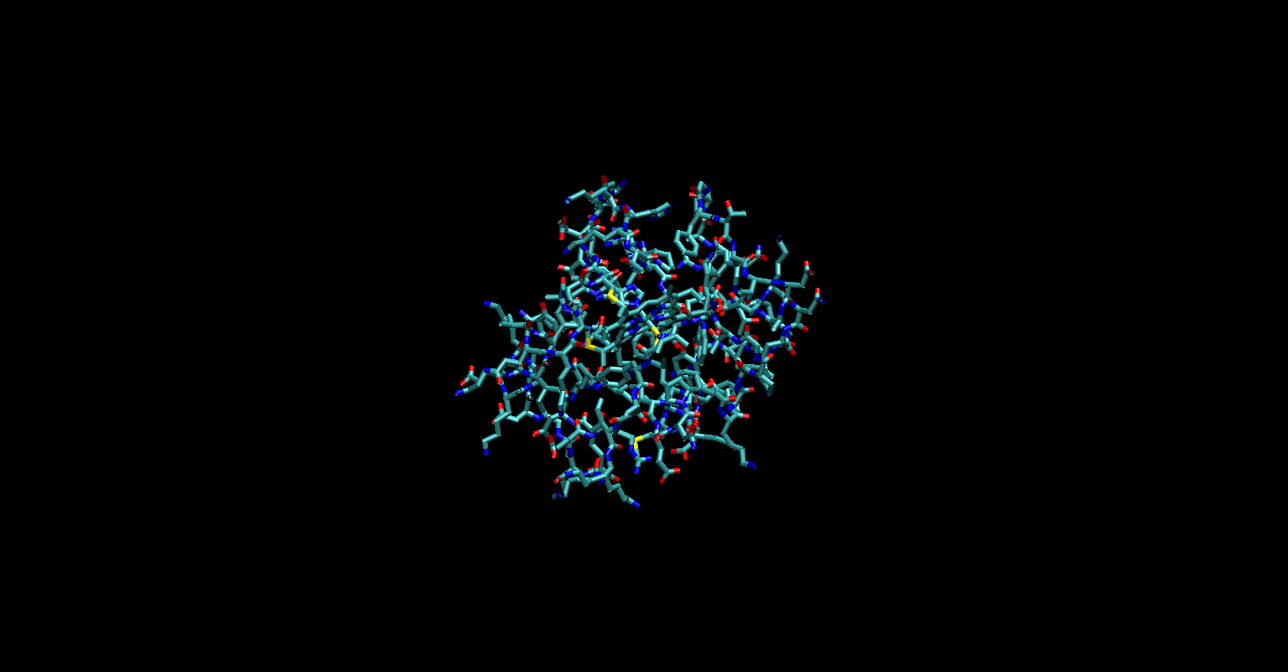
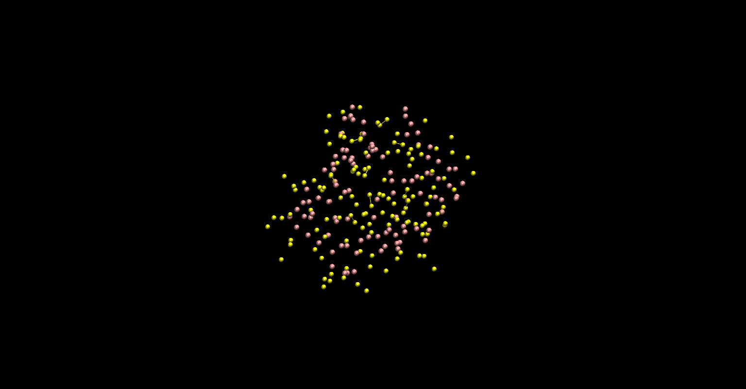
Protein and MARTINI CG Model

Slide 11
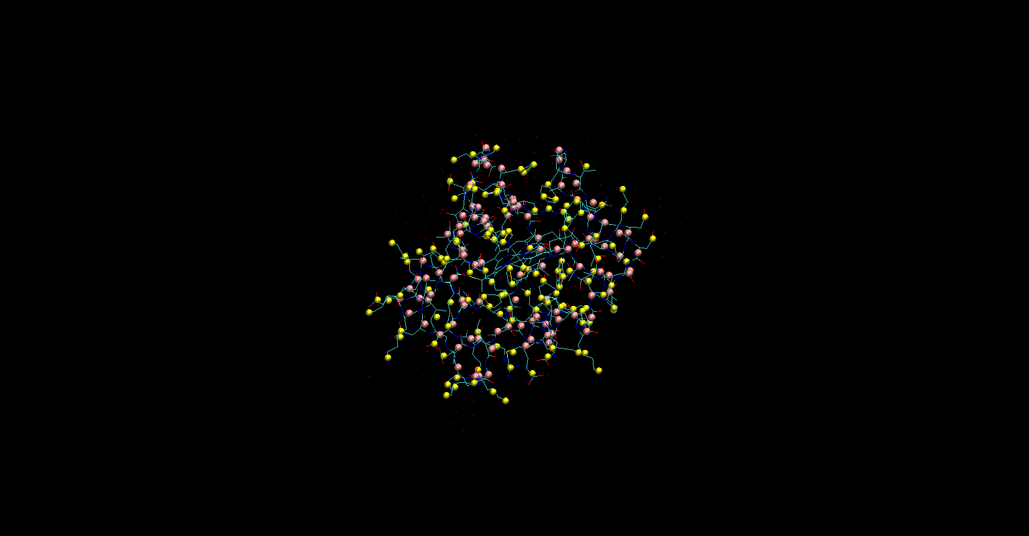

Slide 12
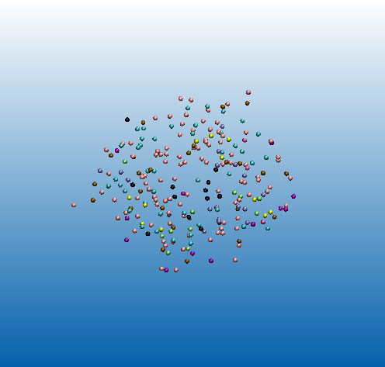
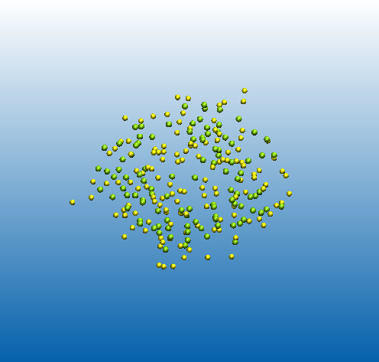
CG structure in Lammps

Slide 13
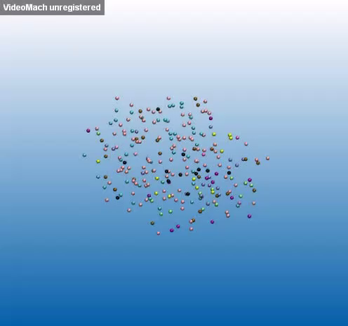
Stability

Slide 14
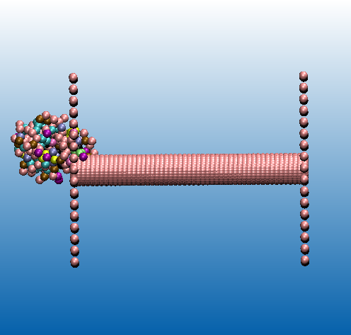
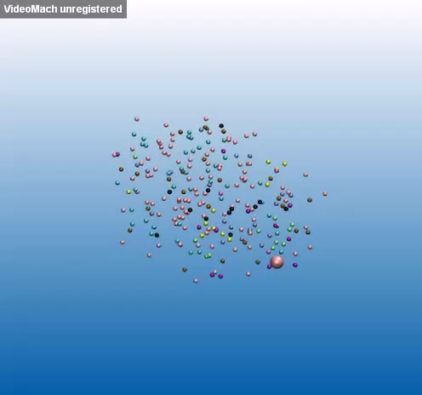
Pore and Protein
Force = 1 Kcal/mole-Angstrom

Slide 15
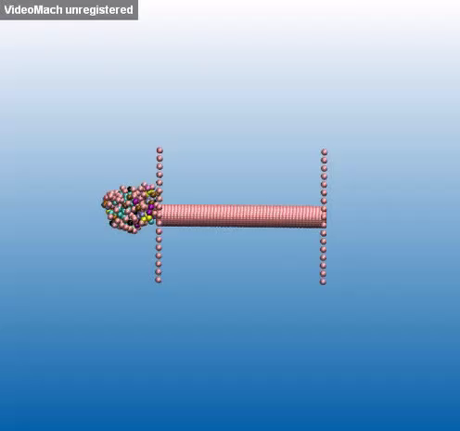
Generating initial conformations
for water (NIST web):
at T = 298.15 K, P = 1atm isothermal, viscosity(n) = 8.9 * 10^-4 Pa.s
Friction/v = 6 pi n r = m/damp
Where, r = 5 * 10^(-10) m
m = 72 g/mol
damp = 1.425 * 10^(-14) s = 14 fs
But this simulation is for damp = 10^4 fs

Slide 16
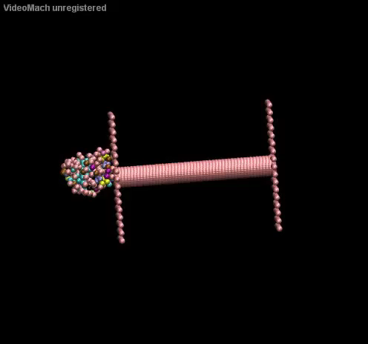
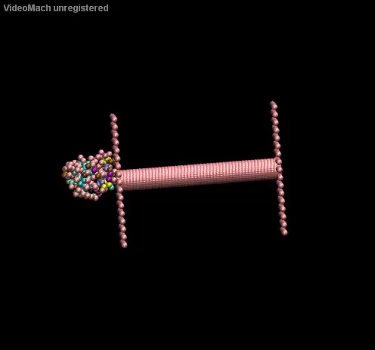
Deciding driving force
E = 10^7 V/m
E = 10^10 V/m

Slide 17
Future Objectives
Find out suitable values for driving force and wall LJ coeff
Simulate the translocation for 500 runs and obtaining the translocation time distribution for these translocation
Analyze these results

Slide 18
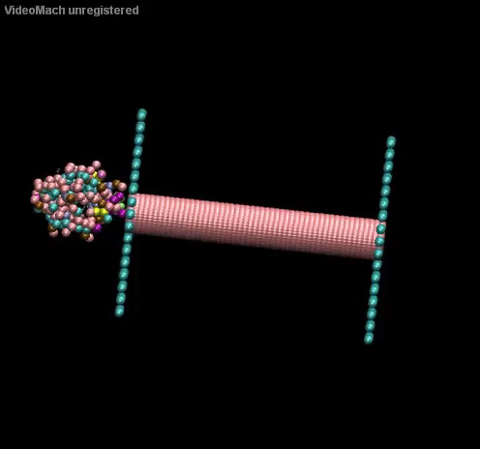
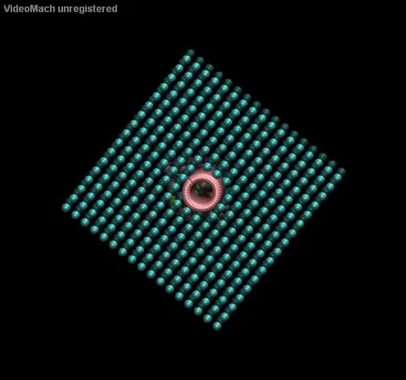

Slide 19
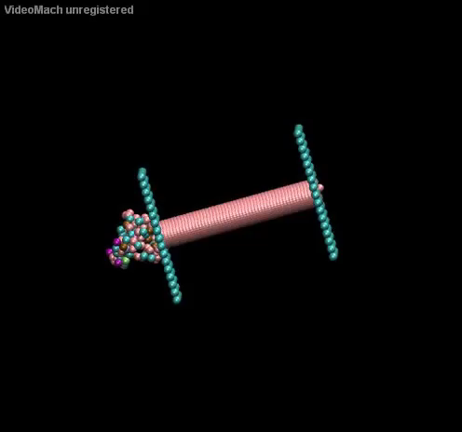

Slide 20
